Slide 1

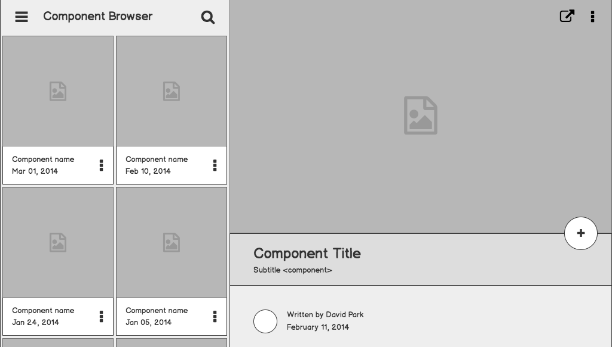
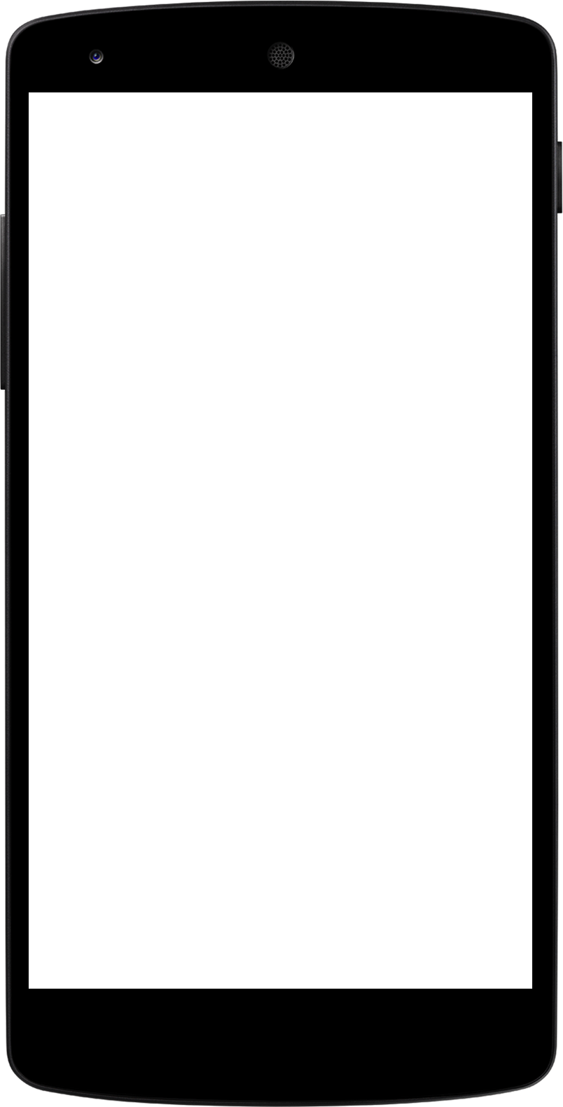
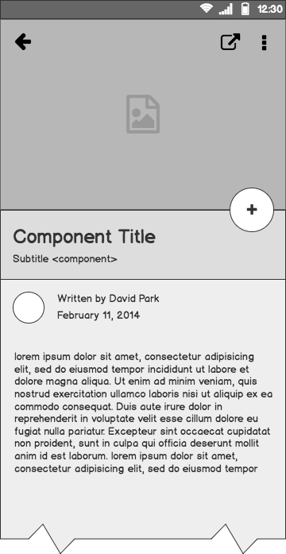
PACMAN API Design
By Team: BigBang

Slide 2
Our Team
Shiyu Wang: (Team Lead)
Weiqian Lu: (Tech Lead)
Kena Du: (Doc Lead)
Lily Fan: (Chief Developer)
Yikai Qian: (Chief Developer)
Xiaoyong Zhang: (Chief Developer)
Notes:
Little intro of our team, what each does

Slide 3
PACMAN GAME
Notes:
So we as a group was asked to design a game called Pacman, which is a blah

Slide 4
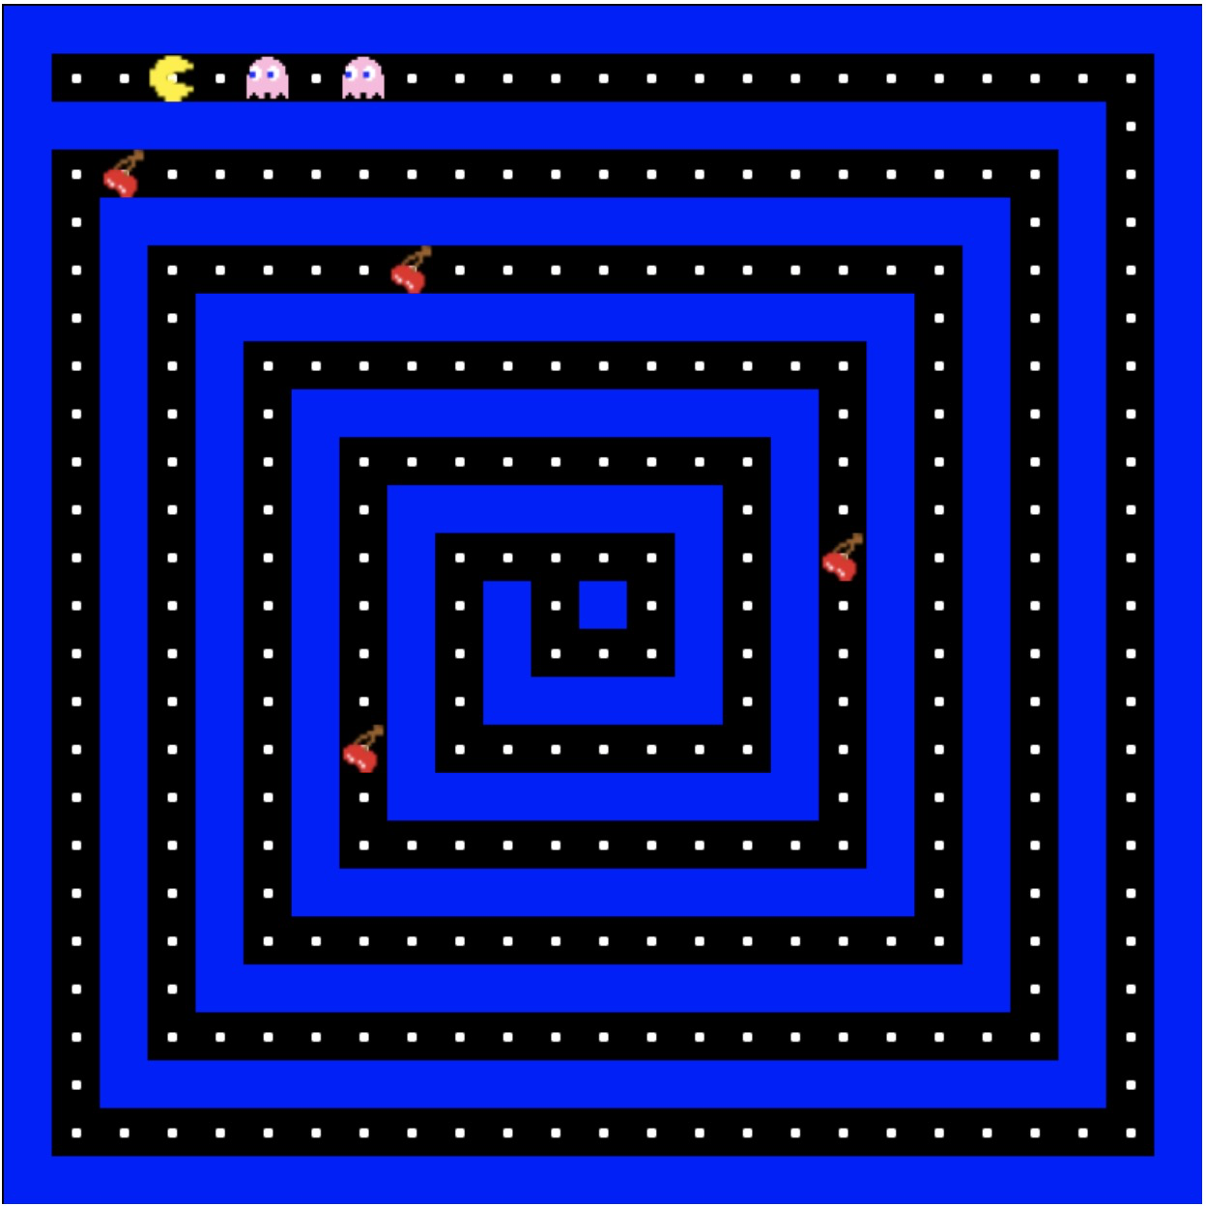
Problem lists
Control Panel Design
Game Logic Design
Notes:
In order to deliver the game on time, we split it in to smaller problem sets.

Slide 5
Control Panel
CUSTOMIZATION
Background Color
Fruit Type
Number of Lives
Start & Reset
WASD Direction Control

Slide 6
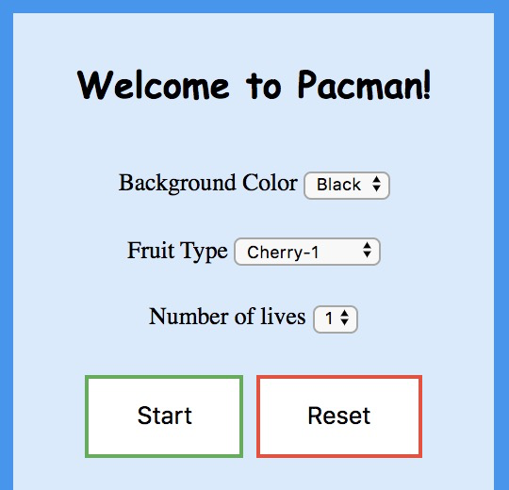
Control Panel
Notes:
In order to deliver the game on time, we split it in to smaller problem sets.

Slide 7
Use Case
PACMAN
Fully controlled by player
Aimed to avoid Ghosts and eat dots
Loses one life if gets caught by Ghost
Able to beat Ghost if it eats Big Dot
Ghosts
Have different strategies
Move faster when level up
Chase nearby PACMAN
Avoid Powered up PACMAN
Big Dots
Allow PACMAN to eat Ghost
Fruits
Have a time out
Add a burst of scores

Slide 8
OverLap

Slide 9

& Overlap
01
Cell Unit
n
n
Cell length n
n x n pixels
Can be a wall, a dot, a fruit, a ghost or a pacman unit.
Dots are eaten by PACMAN if overlapped

Slide 10
& Overlap
02
Direction Sign
nextDir: from keyboard input
currDir: send to update command
prevDir: register, store the previous direction.
In the initial state, all signs are set to STOP direction.
PACMAN loses one life if overlapped; Ghosts are eaten if PACMAN is powered by Big Dot

Slide 11
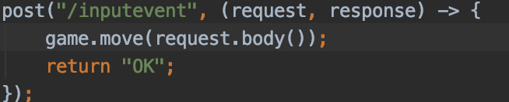

& Overlap
03
⬆signal is sent by specific endpoint:
Pacman set its next move to ⬆, store the current move to prevDir and set its current move to ⬆.
nextDir currDir
currDir prevDir
Pacman update its location to the current direction if it could.
asd
PACMAN updates direction if overlapped with wall

Slide 12
& Overlap
04
nextDir
prevDir
Pacman’s position x == 1.00 cell, that is the pacman cell fits into the dot cell, the pacman is able to move up.
Otherwise, pacman will reset its direction and keep moving towards left.
currDir nextDir
prevDir currDir
Ghosts update direction if overlapped with wall

Slide 13
Design Decision
Flow Chart
Wire Frame
Interface and Abstract

Slide 14
Flow Chart

Slide 15
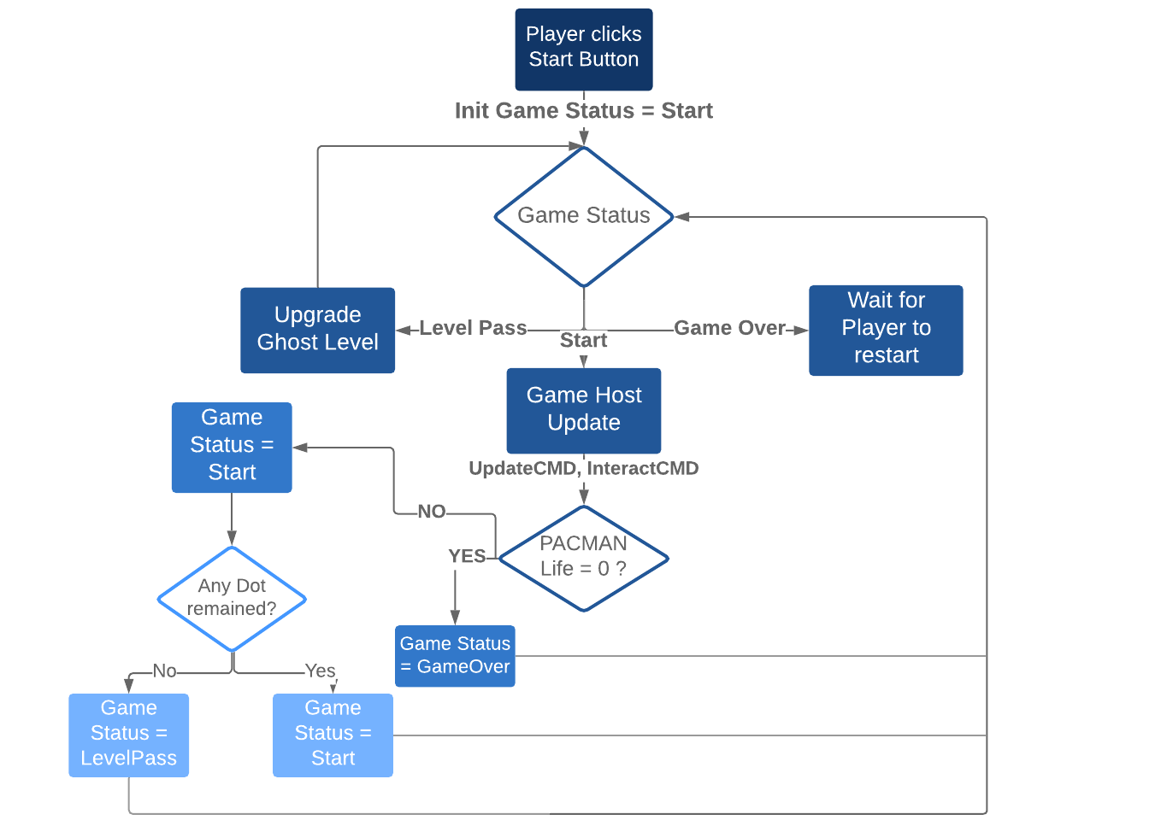
Flow Chart

Slide 16
Wireframe
Notes:
So we as a group was asked to design a game called Pacman, which is a blah

Slide 17
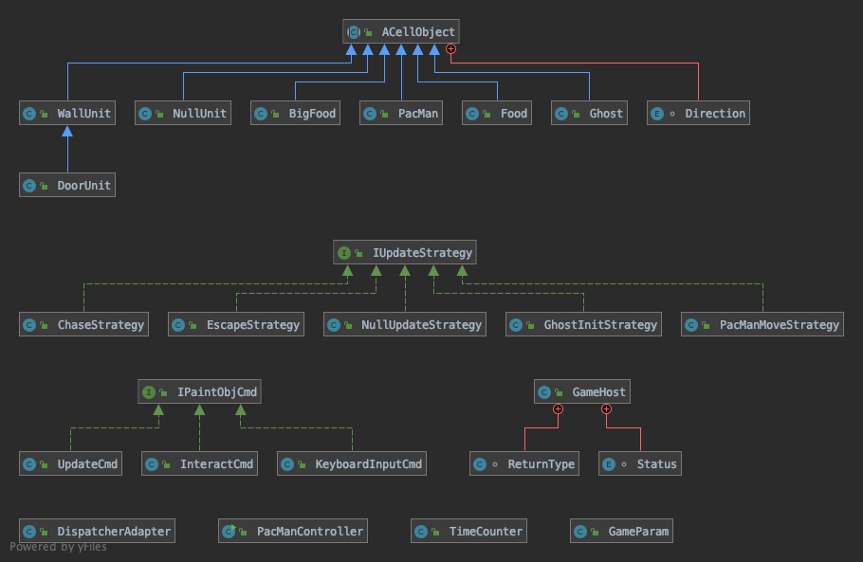
UML Diagram

Slide 18
Interfaces / Abstract Classes

Slide 19
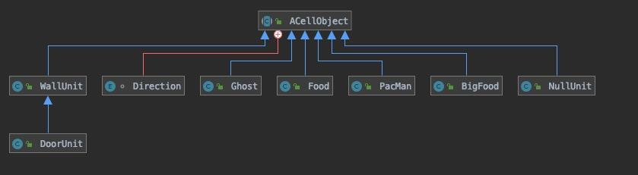
Abstract objects

Slide 20
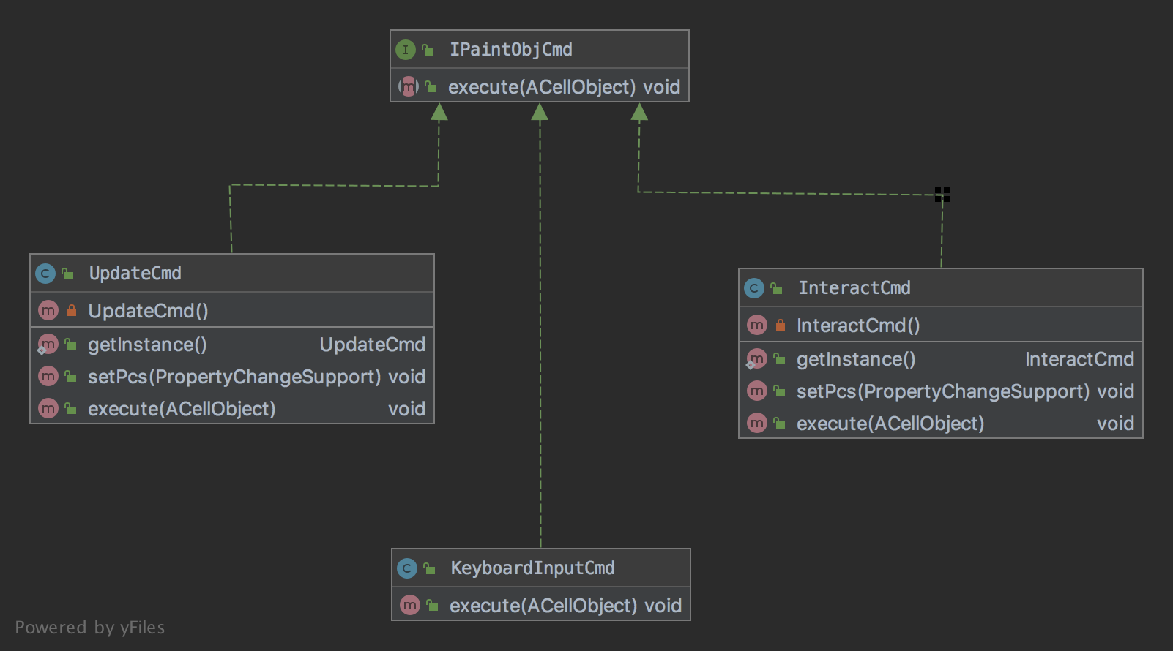
Command Interface

Slide 21
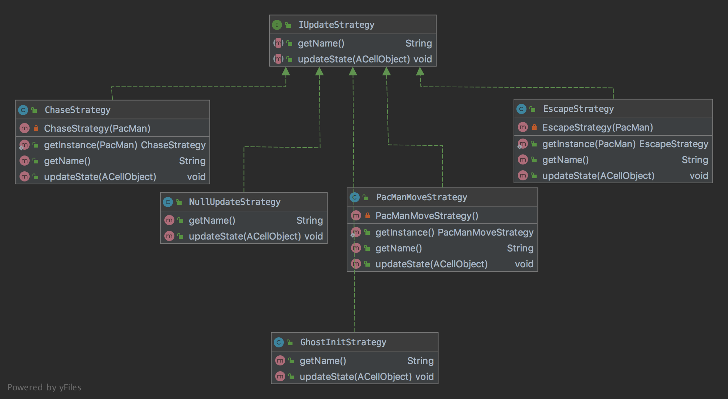
Strategy Interface

Slide 22
Demo
https://pacman-team-bigbang.herokuapp.com/

Slide 23
Questions?

Slide 24
Thanks for Listening!!!

